Slide 1
DHI
The expert in WATER ENVIRONMENTS
Sajid Alam-Manager MIKE Powered by DHI

Slide 2
DHI
DHI is an independent, self-governing research and consultancy organisation (not-for-profit)
DHI builds competence and promotes technological development relevant to the water and the environment
DHI has ongoing activities world-wide
DHI has a total staff of 1000+

Slide 3


DHI
Denmark, Australia, Bulgaria, Canada, China, Czech Republic, France, Germany, India, Italy, Malaysia, New Zealand, Norway, Poland, Romania, Singapore, Slovakia, Spain, South Africa, Sweden, UAE, USA, Brazil, Vietnam, Finland, Greece, Japan, Thailand, UK
The expert in WATER ENVIRONMENTS

Slide 4
DHI (India) Water and Environment Pvt Ltd
Head Office – Delhi
Branch Office – Chandigarh , Chennai , Pune , Assam , Patna , Gujarat, Dehradun
The expert in WATER ENVIRONMENTS

Slide 5
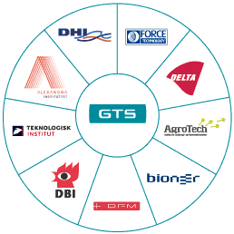

GTS – Advanced Technology Group
DHI – a part of GTS
The GTS institutes are the core of the Danish technological infrastructure
GTS is one of Denmark’s largest consulting networks
Every year we assist more than 20,000 private businesses and public authorities
We serve customers in approx. 100 countries

Slide 6


DHI’s mission
We transform knowledge of water into
value for customers and welfare for the
global community…
Knowledge about water, environment, and health
value and welfare
…We provide solutions by applying and
integrating core competencies within a
management and societal context

Slide 7
DHI’s vision
We aim to be:
The world’s preferred source of specialist knowledge
within our core competencies, striving to influence global
agendas within water and environmental management…
…The world’s leading supplier of hydroinformatic tools. Our technology shall make a difference and set global standards

Slide 8
MIKE Powered by DHI
CITIES – MIKE URBAN & WEST
COAST & SEA – MIKE 21 , MIKE 3 , LIT PACK , ABM Lab , ECO Lab , MIKE C- MAP
WATER RESOURCE – MIKE SHE , MIKE FLOOD , MIKE HYDRO River, MIKE HYDRO Basin , MIKE 21 C
GROUNDWATER & POROUS MEDIA - FEFLOW

Slide 9
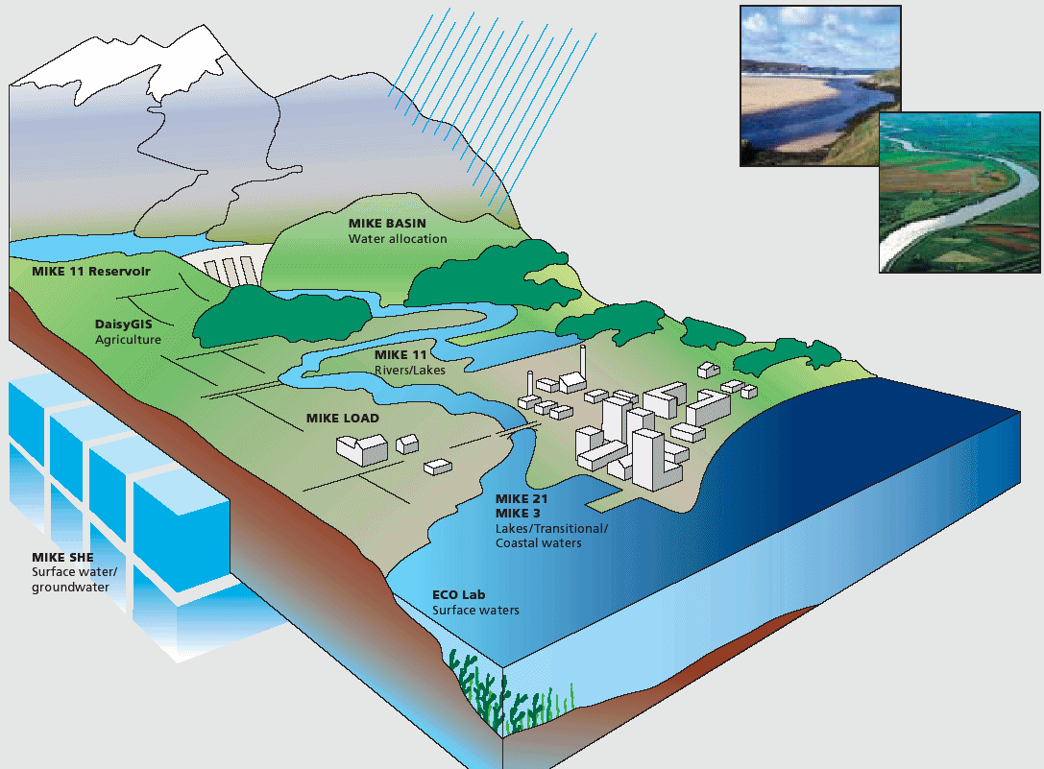
Water resources software products
Designed to address complex water resources management problems
Generic tools with built-in experience
From Hilltop to Ocean (H2O)
Regional and local
Screening level and detailed modelling
Quantity and quality
Surface and subsurface water

Slide 10
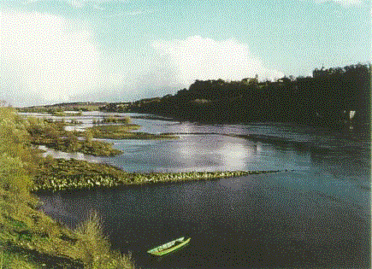
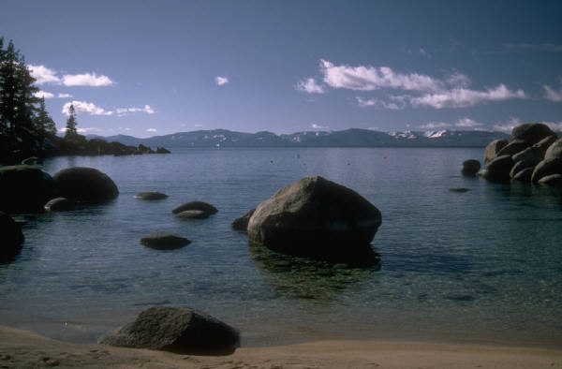
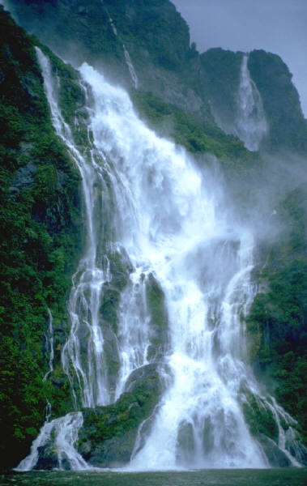
Water resources software products
Flexibility and openness
Model integration (also to 3rd party codes!)
Open ended code architecture
GIS (Arc 10.x) and databases
Web solutions
Real-time
Uncertainty and optimisation
Multiple solvers (Unstructured 1D, 2D, 3D)
…Providing front end technology

Slide 11
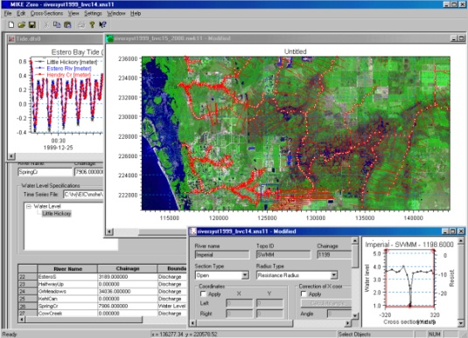
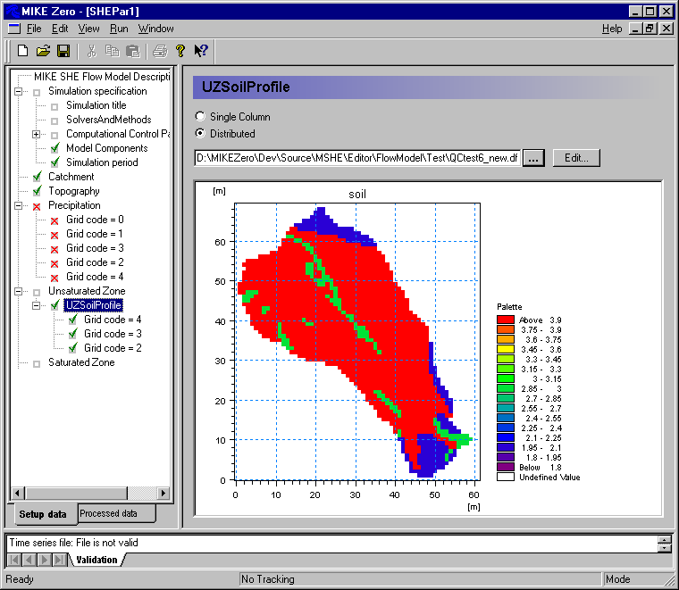
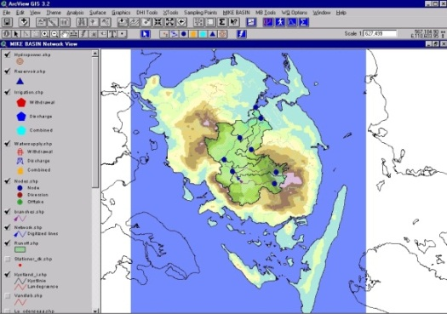
Modelling in practice
Get going, helpful user interfaces;
Communicating results;
Easy access to support - “join the club”;
“Living” software and responsive to needs;
Help to choose the right software;
Combining models in DSSs
...We guard your investment and secure the future
of your modelling resources
Rapid automatic catchment delineation from Digital Elevation Model (DEM)

Slide 12
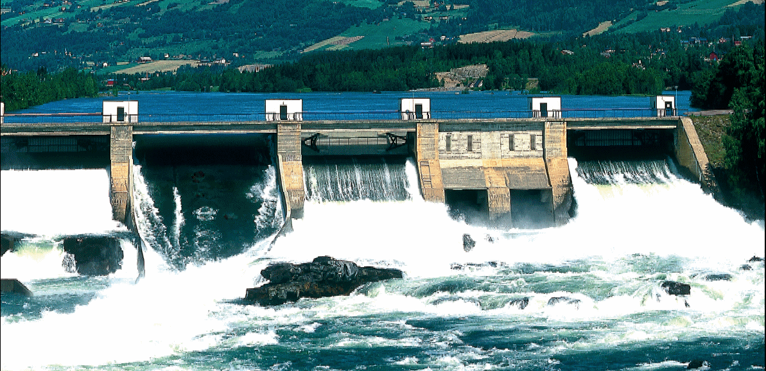

MIKE HYDRO River
Compatible
The most comprehensive and proven approach to hydrodynamic and environmental modelling of rivers, canals, reservoirs, and flood plains
Capabilities ranging from basic to very complex modelling, while yet maintaining user friendliness and efficiency
Flexibility and speed ensures a complete and efficient working environment. MIKE 11 comes with an in-built auto-calibration tool and animation tools
Hydrology
Advection-Dispersion
Water Quality
Flood Mapping
Data Assimilation / Flood Forecasting
Dam Break
Structure Operation
Multi-layered flow
Sediment Transport Module
Graded Sediments
Cohesive Sediments
Extreme Value Analysis
Uncertainty Analysis
GIS tools

Slide 13
MIKE HYDRO River
Compatible
“ River Hydraulics modelling “
By applying MIKE HYDRO River it is possible to answer
The exceedance level in case of flooding- and at which locations will flooding occur?
The long term environmental impact affected by changing pollution loadings?
Where is the sediment deposited in the river system- and what are the overall morphological changes?
The peak concentrations of pollutants at specific locations after heavy polluted loadings from urban catchments or industry plants
Application :
Real Time Flood forecasting
Dam Break Analysis
Reservoir Optimisation
Ecology & Water quality assessments
Flood alleviation design studies
Water quality forecasting
Sediment Transport

Slide 14
MIKE HYDRO River
Compatible
Modules :
RR – Rainfall Runoff
SO – Structure Operations
DB – Dam Break
AUTOCAL – Automatic Calibration
DA – Data Assimilation / Flood Forecasting
AD – Advection – Dispersion
ECO LAB – Ecological Modelling
SEDIMENT MODELLING – Cohesive and Non Cohesive Sediment
Benefits :
Reliability
Versatility
Productivity
Quality
More features than any other river modelling packages

Slide 15
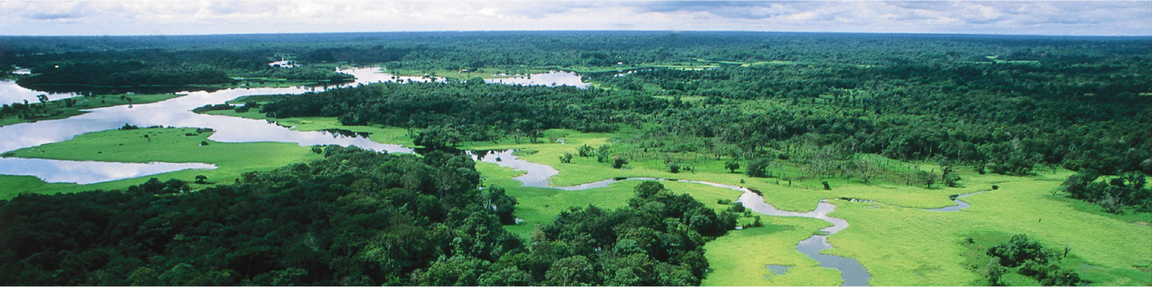
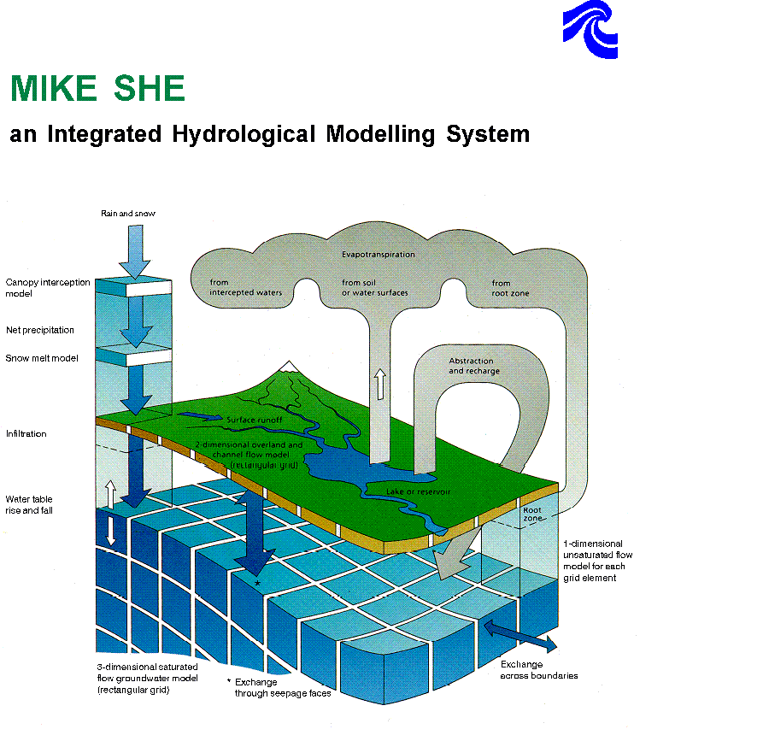
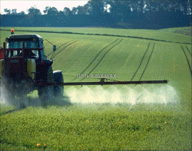
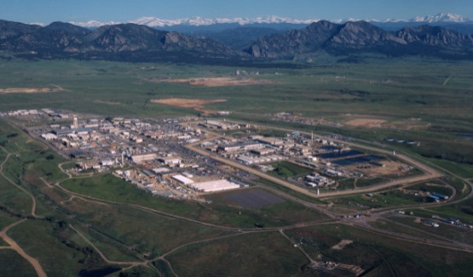
MIKE SHE
Spatially distributed rainfall-runoff modelling and
integrated groundwater and surface water modelling
Unique and well-proven modelling system for integrated
modelling of watersheds with options for numerous
process descriptions in all phases of the hydrological cycle
Compatible
Notes:
My background
DHI background
MIKE SHE History
MIKE SHE Deployment

Slide 16
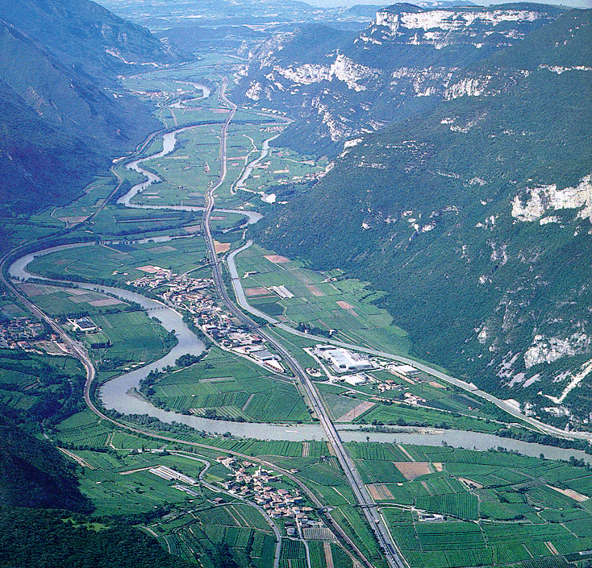
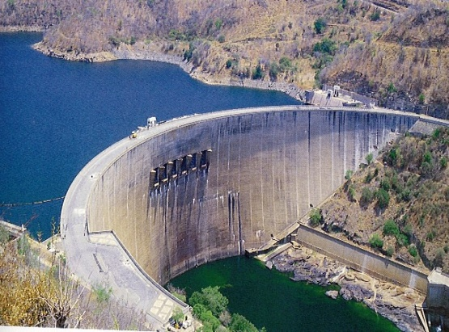
MIKE HYDRO BASIN
Multipurpose, map-based decision support tool for integrated water resources analysis, planning and management of river basins.
Multisector solution alternatives to water allocation and water shortage problems.
Climate change impact assessments on water resources availability and quality.
Optimisation of reservoir and hydropower operations.
Evaluation and improvement of irrigation scheme performance
Integrated water resource management ( IWRM ) studies.
Global ranking of water users securing water allocation from priority controlled demands.

Slide 17
MIKE 21 C
Primary focus on sediment transport and river morphology.
Analysing flow fields and flood dynamics in rivers and adjacent flood plains.
Reservoirs Sedimentation
Designing protection schemes against erosion.
Predicting sedimentation of water intakes, outlets, locks and harbours
Modules :
ST – Sediment Transport
HD – Hydrodynamics
PP – Preprocessing and Postprocessing

Slide 18

Outline of application areas
Be on top of the world - know your needs!
The choice of software is not always obvious
Several DHI products offer solutions to the same problems,
but with slightly different focus
We can help you with the right choice…

Slide 19
Outline of application areas
MIKE HYDRO River | MIKE SHE | MIKE FLOOD | MIKE BASIN | MIKE 21C | APPLICATION
 | ✓✓ |  |  |  | Groundwater Management & Development
 | ✓✓ |  |  |  | Watershed Hydrology
 |  |  | ✓✓ |  | River Basin Planning & Management
✓✓ |  |  |  |  | River & Canal Hydraulics
✓✓ |  |  | ✓✓ |  | Reservoir Operation and Management
 | ✓✓ |  |  |  | Soil & Groundwater Contamination
✓✓ |  | ✓✓ |  |  | Flood forecasting and Flood Alleviation
✓ | ✓✓ |  |  |  | Wetland Protection and Restoration
✓✓ | ✓ |  | ✓ |  | Water Quality & Ecology
✓ |  |  |  | ✓✓ | Sediment Transport & Morphology
 | ✓✓ |  | ✓✓ |  | Irrigation in Agriculture
 | ✓ |  | ✓✓ |  | Integrated Water Resources Management

Slide 20

Conclusion
We have the tools
  state-of-the art
  tested / applied / reviewed / compared
  ensure sustainability and continued support
We have the ability to tailor the software to your needs
We are committed to develop a partnership
  well-qualified staff
  organisation

Slide 21
THANK YOU
Sajid Alam

